Slide 1
The 8051 Microcontroller and Embedded Systems
CHAPTER 4
I/O PORT PROGRAMMING
vignan university

Slide 2
OBJECTIVES
List the 4 ports of the 8051
Describe the dual role of port 0 in providing both data and addresses
Code Assembly language to use the ports for input or output
Explain the dual role of port 0 and port 2
Code 8051 instructions for I/O handling
Code I/O bit-manipulation programs for the 8051
vignan university

Slide 3
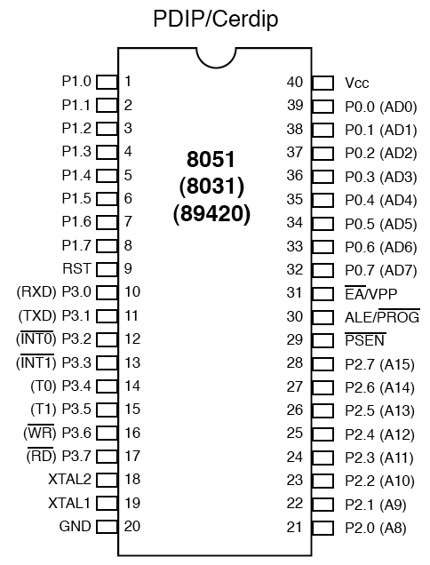
SECTION 4.1: 8051 I/O PROGRAMMING
I/O port pins and their functions
Figure 4–1 8051 Pin Diagram
vignan university

Slide 4
SECTION 4.1: 8051 I/O PROGRAMMING
All the ports upon RESET are configured as inputs, ready to be used as input ports.
When the first 0 is written to a port, it becomes an output.
To reconfigure it as an input, a 1 must be sent to the port.
To use any of these ports as an input port, it must be programmed.
vignan university

Slide 5
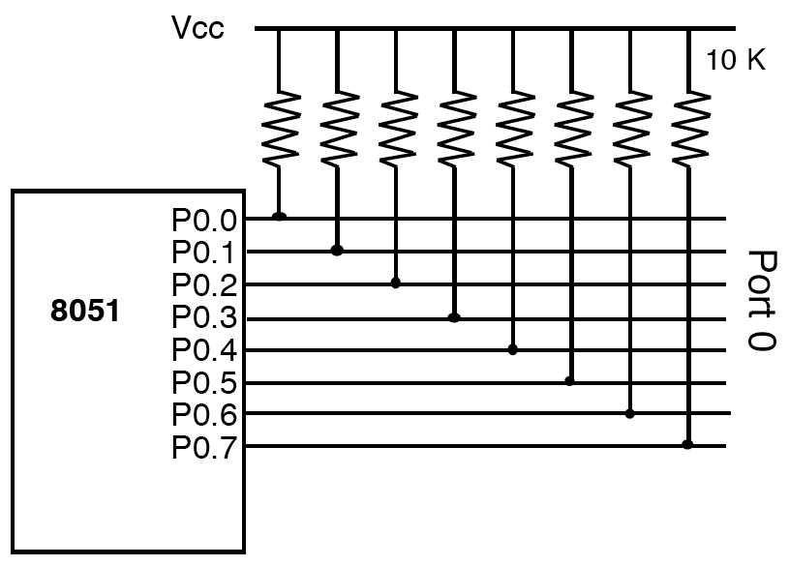
SECTION 4.1: 8051 I/O PROGRAMMING
Port 0
Figure 4–2
Port 0 with Pull-Up Resistors
vignan university

Slide 6
Port 0
It can be used for input or output.
To use the pins of port 0 as both input and output each pin must be connected externally to a 10 Kohm pull-up resistor.
This is due to the fact that P0 is an open drain, unlike P 1, P2, and P3
vignan university

Slide 7
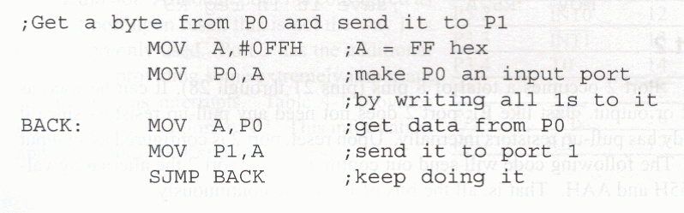
Port 0 as input
With resistors connected to port 0, in order to make it an input, the port must be programmed by writing 1 to all the bits.
vignan university

Slide 8
Dual role of port 0
Port 0 is also designated as AD0 - AD7, allowing it to be used for both address and data.
When connecting an 8051/31 to an external memory, port 0 provides both address and data.
The 8051 multiplexes address and data through port 0 to save pins. We discuss that in Chapter 14.
vignan university

Slide 9
SECTION 4.1: 8051 I/O PROGRAMMING
Port 1
It can be used as input or output.
This port does not need any pull-up resistors since it already has pull-up resistors internally.
Upon reset, port I is configured as an input port.
vignan university

Slide 10
Port 1 as input
If port 1 has been configured as an output port, to make it an input port again, it must programmed as such by writing 1 to all its bits.
vignan university

Slide 11
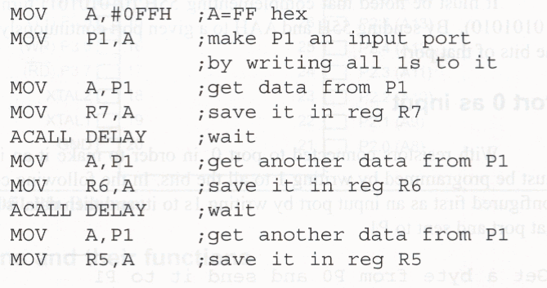
Port 1 as input
In the following code, port 1 is configured first as an input port by writing 1 s to it, then data is received from that port and saved in R7, R6, and R5.
vignan university

Slide 12
SECTION 4.1: 8051 I/O PROGRAMMING
Port 2
Port 2 occupies a total of 8 pins (pins 21 through 28).
It can be used as input or output.
Port 2 does not need any pull-up resistors since it already has pull-up resistors internally.
Upon reset, port 2 is configured as an input port.
vignan university

Slide 13
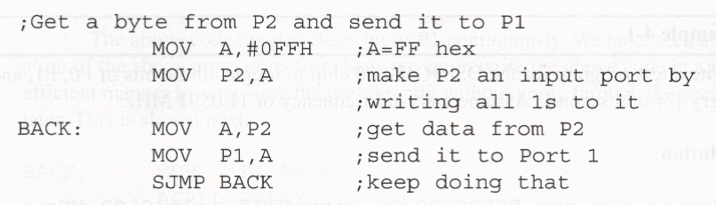
Port 2 as input
To make port 2 an input, it must programmed as such by writing 1 to all its bits.
In the following code, port 2 is configured first as an input port by writing is to it.
vignan university

Slide 14
Dual role of port 2
In 8031-based systems, port 2 must be used along with P0 to provide the 16-bit address for external memory.
Port 2 is also designated as A8 - A15, indicating its dual function.
Since an 8051/31 is capable of accessing 64K bytes of external memory, it needs a path for the 16 bits of the address.
P0 provides the lower 8 bits via A0 - A7
P2 provides bits A8 - A 15 of the address.
When the 8051 /31 is connected to external memory, P2 is used for the upper 8 bits of the 16-bit address, and it cannot be used for I/O.
vignan university

Slide 15
Port 3
Port 3 can be used as input or output.
P3 does not need any pull-up resistors.
Port 3 is configured as an input port upon reset.
Port 3 has the additional function of providing some extremely important signals such as interrupts, serial I/O, timer/counter and read/write control for external memory.
vignan university

Slide 16
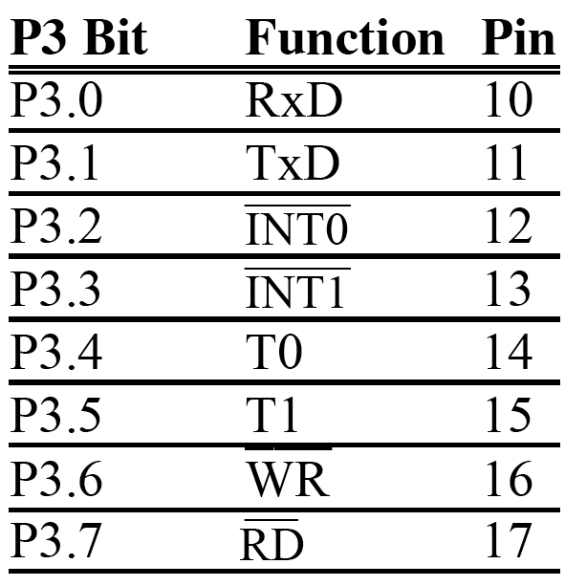
SECTION 4.1: 8051 I/O PROGRAMMING
Port 3
Table 4–1
Port 3 Alternate Functions
vignan university

Slide 17
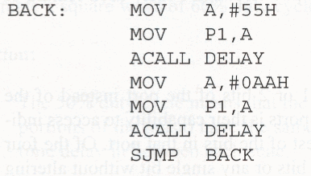
SECTION 4.1: 8051 I/O PROGRAMMING
Different ways of accessing the entire 8 bits
vignan university

Slide 18
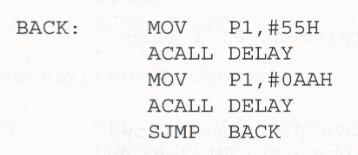
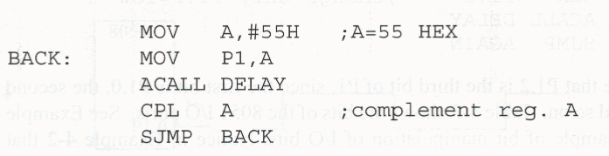
Different ways of accessing the entire 8 bits
vignan university

Slide 19
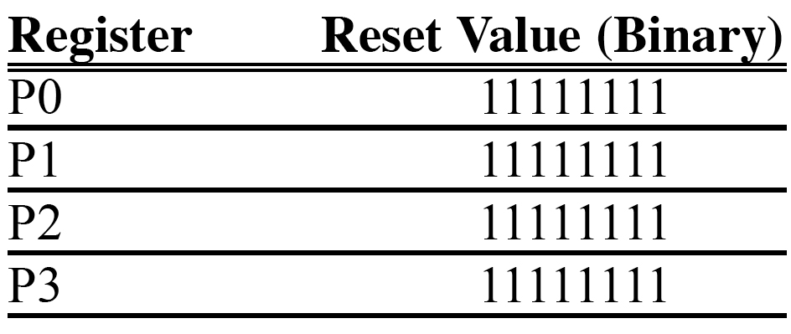
SECTION 4.1: 8051 I/O PROGRAMMING
Ports status upon reset
Table 4–2 Reset Value of Some 8051 Ports
vignan university

Slide 20
SECTION 4.2: I/O BIT MANIPULATION PROGRAMMING
A powerful feature of 80511/0 ports is their capability to access individual bits of the port without altering the rest of the bits in that port.
Of the four 8051 ports, we can access either the entire 8 bits or any single bit without altering the rest.
"SETB X. Y" where X is the port number 0, 1, 2, or 3, and Y is the desired bit number from 0 to 7 for data bits DO to D7.
"SETB P1.5" sets high bit 5 of port 1.
vignan university

Slide 21
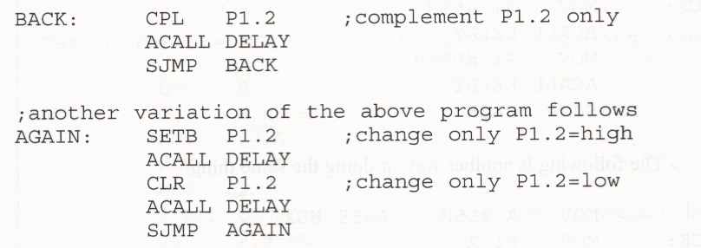
SECTION 4.2: I/O BIT MANIPULATION PROGRAMMING
The following code toggles bit P1.2 continuously.
vignan university

Slide 22
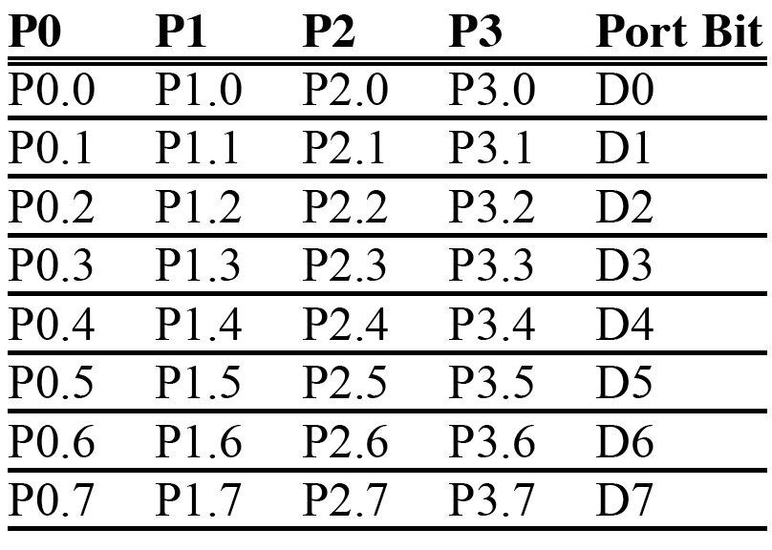
SECTION 4.2: I/O BIT MANIPULATION PROGRAMMING
I/O ports and bit-addressability
Table 4–3
Single-Bit Addressability
of Ports
vignan university

Slide 23
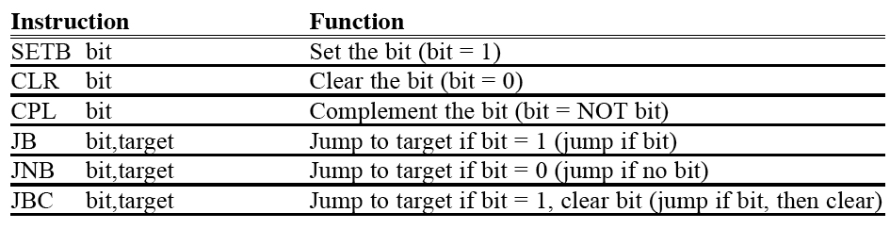
SECTION 4.2: I/O BIT MANIPULATION PROGRAMMING
I/O ports and bit-addressability
Table 4–4 Single-Bit Instructions
vignan university

Slide 24
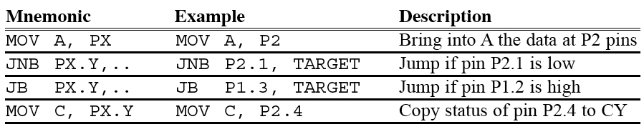
SECTION 4.2: I/O BIT MANIPULATION PROGRAMMING
Checking an input bit
Table 4–5 Instructions For Reading an Input Port
vignan university

Slide 25
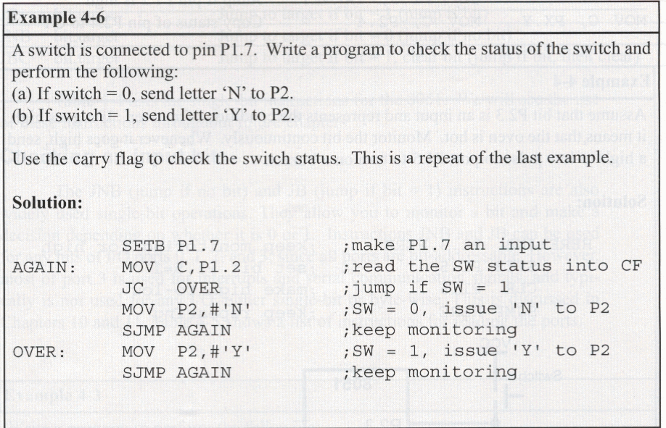
Reading a single bit into the carry flag
vignan university

Slide 26
Reading input pins vs. port latch
Some instructions read the status of port pins while others read the status of an internal port latch.
When reading ports there are two possibilities:
  1. Read the status of the input pin.
  2. Read the internal latch of the output port.
vignan university

Slide 27
Instructions for reading input ports
To make any bit of any 8051 port an input port, we must write 1 (logic high) to that bit.
After we configure the port bits as input, we can use only certain instructions in order to get the external data present at the pins into the CPU.
vignan university

Slide 28
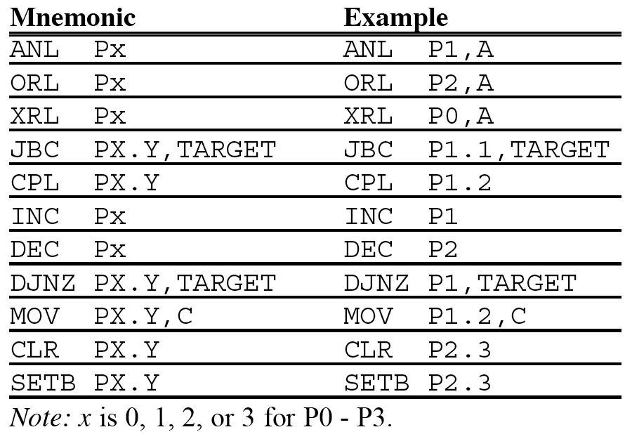
Reading latch for output port
vignan university
Table 4–6 Instructions Reading a Latch (Read-Modify-Write)

Slide 29

Read-modify-write feature
The ports in the 8051 can be accessed by the read-modify-write technique.
  (1) reading the port
  (2) modifying its value
  (3) writing to the port
vignan university

Slide 30
Next …
Lecture Problems Textbook Chapter 4
  Answer as many questions as you can and submit via MeL before the end of the lecture.
Proteus Exercise Textbook Chapter 4
  Do as much of the Proteus exercise as you can and submit via MeL before the end of the lecture.
vignan university

